Slide 1
Computer Networks CS 3001 (BCS-5B) Lecture 3
Danyal Farhat
FAST School of Computing
NUCES Lahore

Slide 2

Chapter 3 Transport Layer
A note on the use of these PowerPoint slides:
We’re making these slides freely available to all (faculty, students, readers). They’re in PowerPoint form so you see the animations; and can add, modify, and delete slides (including this one) and slide content to suit your needs. They obviously represent a lot of work on our part. In return for use, we only ask the following:
If you use these slides (e.g., in a class) that you mention their source (after all, we’d like people to use our book!)
If you post any slides on a www site, that you note that they are adapted from (or perhaps identical to) our slides, and note our copyright of this material.
For a revision history, see the slide note for this page.
Thanks and enjoy! JFK/KWR
All material copyright 1996-2023
J.F Kurose and K.W. Ross, All Rights Reserved
Computer Networking: A Top-Down Approach 8th edition Jim Kurose, Keith Ross Pearson, 2020
Notes:
Version History
8.0 (April 2020)
All slides reformatted for 16:9 aspect ratio
All slides updated to 8th edition material
Use of Calibri font, rather that Gill Sans MT
Add LOTS more animation throughout
added new 8th edition material on QUIC, CUBIC, delay-based congestion control
lighter header font
8.2 (July 2023): changes from 8.0
minor updates throughout, but not much changes from 8.0

Slide 3

Chapter 3: roadmap
Transport-layer services
Multiplexing and demultiplexing
Connectionless transport: UDP
Principles of reliable data transfer
Connection-oriented transport: TCP
Principles of congestion control
TCP congestion control

Slide 4
Multiplexing/demultiplexing
Extending host-to-host delivery to process-to-process delivery is called transport-layer multiplexing and demultiplexing.
UDP and TCP provide integrity checking by including error detection fields in their segments’ headers.
Process-to-Process data delivery and error checking—are the only two services that UDP provides.

Slide 5

Multiplexing/demultiplexing (Cont.)
multiplexing as sender:
demultiplexing as receiver:
handle data from multiple
sockets, add transport header (later used for demultiplexing)
use header info to deliver
received segments to correct
socket
application
application
P1
P2
application
socket
P3
transport
P4
process
transport
network
transport
network
link
network
link
physical
link
physical
physical

Slide 6




HTTP server
client
application
application
HTTP msg
transport
H_{t}
HTTP msg
H_{n}
H_{t}
network
transport
HTTP msg
transport
H_{n}
H_{t}
link
network
network
HTTP msg
link
physical
link
physical
physical
H_{n}
H_{t}
HTTP msg

Slide 7

Q: how did transport layer know to deliver message to Firefox browser process rather then Netflix process or Skype process?
client
application
application
HTTP msg
HTTP msg
transport
H_{t}
HTTP msg
transport
network
transport
network
link
network
link
physical
link
physical
physical

Slide 8
?
de-multiplexing

Slide 9
application
?
transport
de-multiplexing

Slide 10
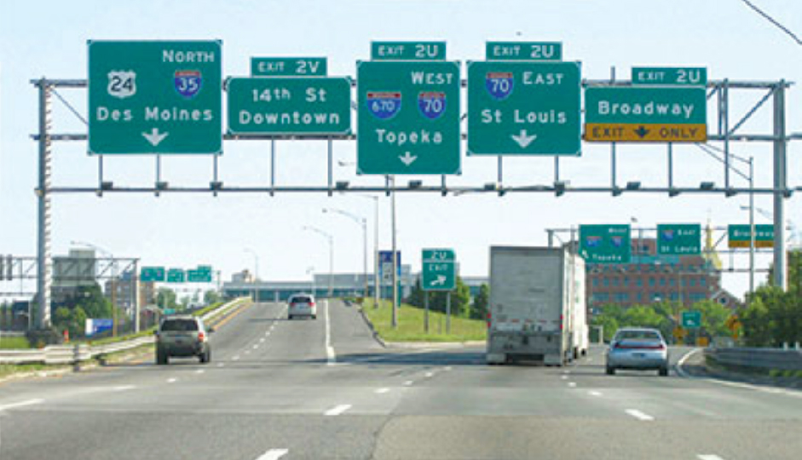
Demultiplexing

Slide 11


Slide 12
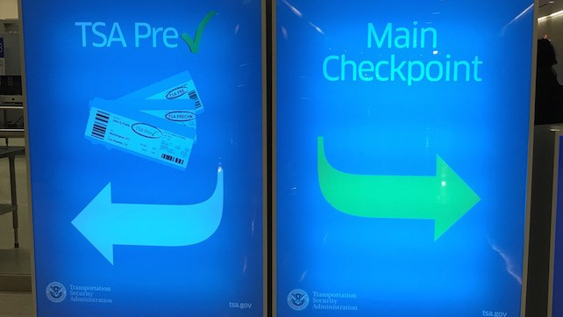

Slide 13
multiplexing

Slide 14
application
transport
multiplexing

Slide 15

Multiplexing

Slide 16
How demultiplexing works
host receives IP datagrams
each datagram has source IP address, destination IP address
each datagram carries one transport-layer segment
each segment has source, destination port number
host uses IP addresses & port numbers to direct segment to appropriate socket
32 bits
source port #
dest port #
other header fields
application
data
(payload)
TCP/UDP segment format

Slide 17
Connectionless demultiplexing
Recall:
when creating socket, must specify host-local port #:
DatagramSocket mySocket1 = new DatagramSocket(12534);
when receiving host receives UDP segment:
checks destination port # in segment
directs UDP segment to socket with that port #
when creating datagram to send into UDP socket, must specify
destination IP address
destination port #
IP/UDP datagrams with same dest. port #, but different source IP addresses and/or source port numbers will be directed to same socket at receiving host

Slide 18
Connectionless demultiplexing: an example
mySocket = socket(AF_INET,SOCK_DGRAM)
mySocket.bind(myaddr,6428);
mySocket = socket(AF_INET,SOCK_STREAM)
mySocket.bind(myaddr,9157);
mySocket = socket(AF_INET,SOCK_STREAM)
mySocket.bind(myaddr,5775);
application
application
P1
application
P3
P4
transport
transport
network
transport
network
link
network
link
physical
link
physical
physical
B
D
source port: 6428
dest port: 9157
source port: ?
dest port: ?
A
C
source port: 9157
dest port: 6428
source port: ?
dest port: ?

Slide 19
Connection-oriented demultiplexing
TCP socket identified by 4-tuple:
source IP address
source port number
dest IP address
dest port number
server may support many simultaneous TCP sockets:
each socket identified by its own 4-tuple
each socket associated with a different connecting client
demux: receiver uses all four values (4-tuple) to direct segment to appropriate socket

Slide 20
Connection-oriented demultiplexing: example
application
application
P4
P5
P6
application
P1
P2
P3
transport
transport
network
transport
network
link
network
link
physical
link
physical
server: IP address B
physical
host: IP address A
source IP,port: B,80
dest IP,port: A,9157
host: IP address C
source IP,port: C,5775
dest IP,port: B,80
source IP,port: A,9157
dest IP, port: B,80
source IP,port: C,9157
dest IP,port: B,80
Three segments, all destined to IP address: B,
dest port: 80 are demultiplexed to different sockets

Slide 21
Summary
Multiplexing, demultiplexing: based on segment, datagram header field values
UDP: demultiplexing using destination port number (only)
TCP: demultiplexing using 4-tuple: source and destination IP addresses, and port numbers
Multiplexing/demultiplexing happen at all layers

Slide 22
Additional Resources – Chapter 1 Videos
What is the Internet
https://www.youtube.com/watch?v=Dxcc6ycZ73M&t=68s
Network Protocols
https://www.youtube.com/watch?v=BnWn18qUYyA
Edge Computing
https://www.youtube.com/watch?v=3hScMLH7B4o&t=26s
OSI Reference Model
https://www.youtube.com/watch?v=9zqHMl9_s5k

Slide 23
Additional Resources – Chapter 2 Videos
HTTP Versions
https://www.youtube.com/watch?v=a-sBfyiXysI
What is SMTP
https://www.youtube.com/watch?v=AoqvWgazf50
DNS
https://www.youtube.com/watch?v=27r4Bzuj5NQ&t=40s

Slide 24
Thank You!

